Slide 1
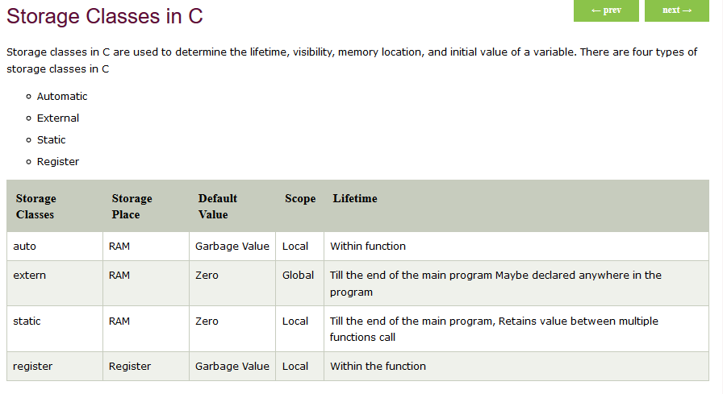

Slide 2
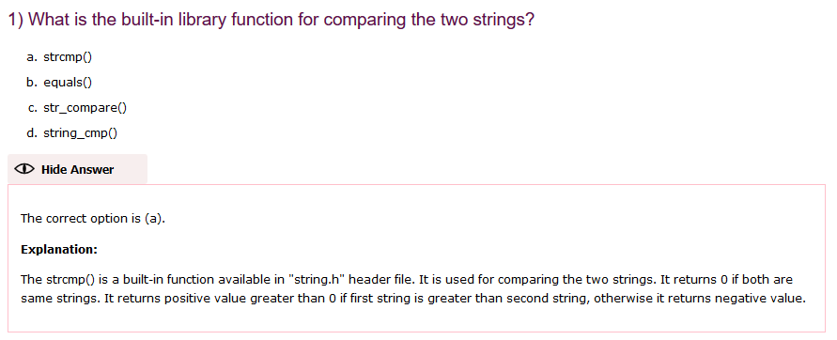

Slide 3
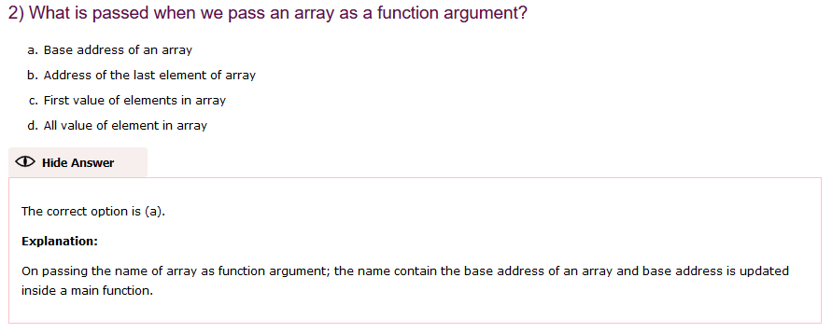

Slide 4
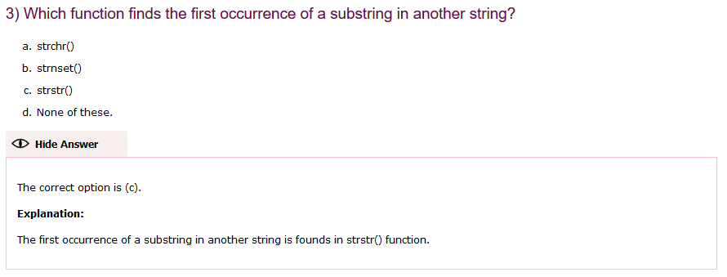

Slide 5
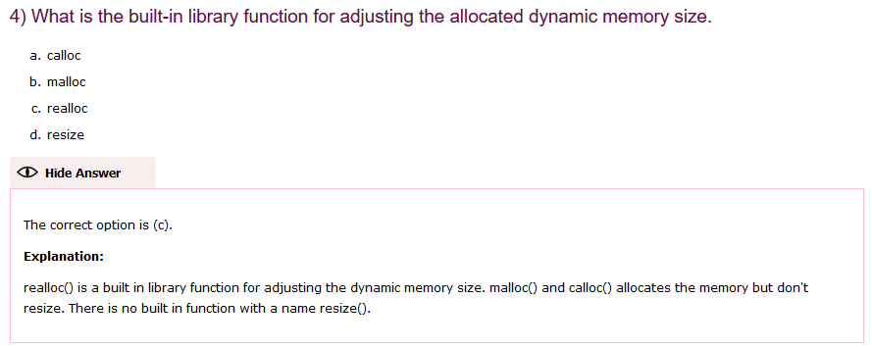

Slide 6
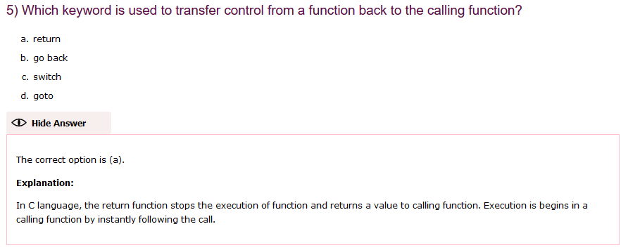

Slide 7
#include<stdio.h>
main(){
int a=5;
int c = a++ + a++ + a++ + a++;
printf("%d",c);
}
Valuate from right with postincement (c=8+7+6+5)

Slide 8
main(){
int a=5;
int c=++a + ++a + ++a + ++a + ++a;
printf("%d",c);
}
The + operator wants two operants to add so first initially a=6 and a=7 for second operation and goes on
C=(7+7+8+9+10)

Slide 9
#include<stdio.h>
main(){
int a=5;
int c = ++a + a++ + ++a;
printf("\n %d",c);
}
Here the first operator is ++a and second is a++ , since a++ ‘+’ operator takes two input for incrementing
So c = (7 + 6 + 8)

Slide 10
#include<stdio.h>
main(){
int a=5;
int c = ++a + a++ + a++;
printf("\n %d",c);
}

Slide 11
#include<stdio.h>
main(){
int a=5;
int c = a++ + ++a + a++;
printf("\n %d",c);
}
Here the first operator is a++ , so normal increament operation can be done
C = 5 + 7 + 7

Slide 12
#include<stdio.h>
main(){
printf("%d",printf("hello"));
}

Slide 13

#include "stdio.h"
int main()
{
int x, y = 5, z = 5;
x = y == z;
printf("\n\t%d", x);
getchar();
return 0;
}

Slide 14
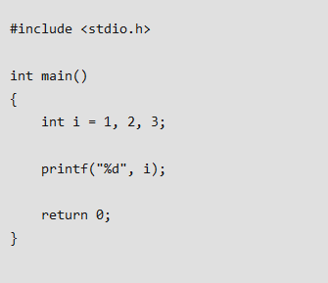

Slide 15
#include <stdio.h>
int main()
{
int i = 1;
i=1,2,3;
printf("%d", i);
return 0;
}

Slide 16
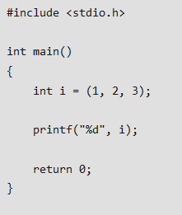

Slide 17
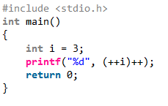

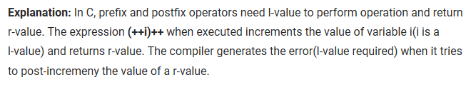

Slide 18
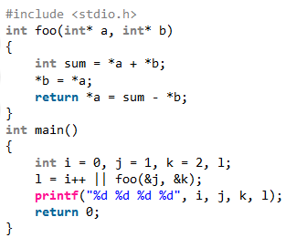

Slide 19
#include <stdio.h>
int main()
{
int i = 5, j = 10, k = 15;
printf("%d ", sizeof(i=i+2));
printf("%d", i);
return 0;
}
An expression cannot be evaluated inside sizeof operator

Slide 20
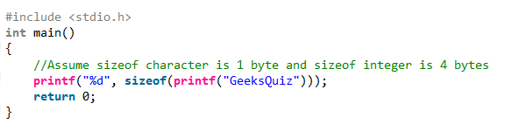


Slide 21
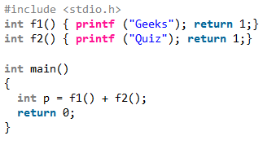
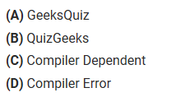



Slide 22
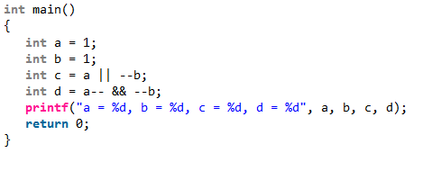


Slide 23
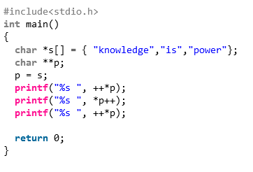
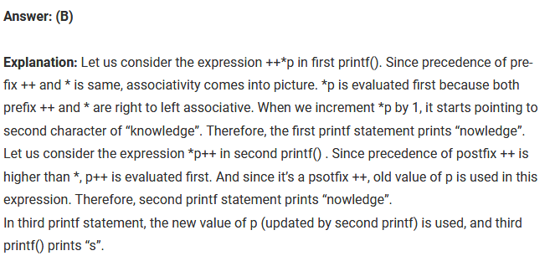
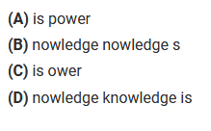

Slide 24
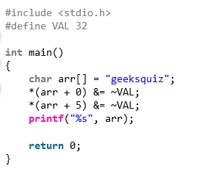
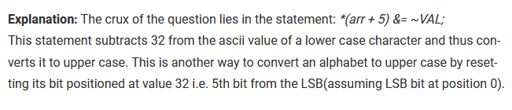

Slide 25
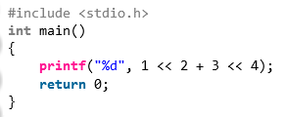
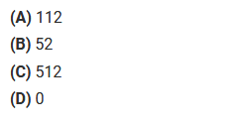
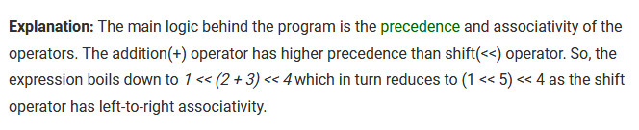


Slide 26
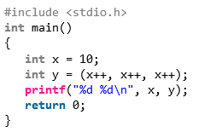

Slide 27
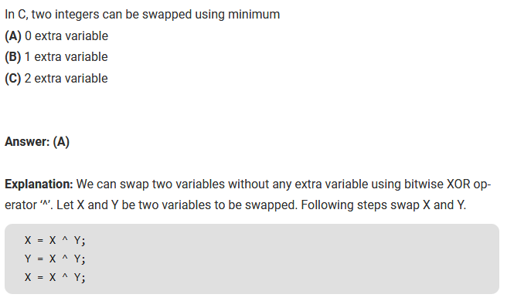

Slide 28

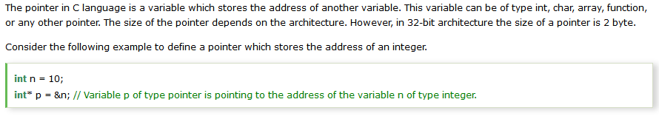

Slide 29
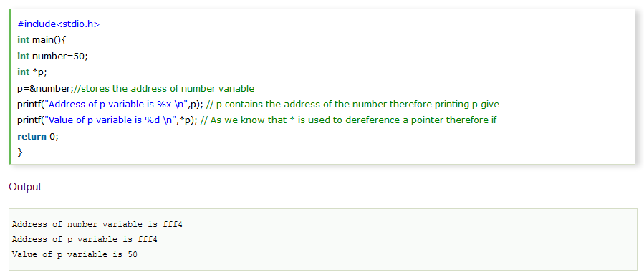

Slide 30
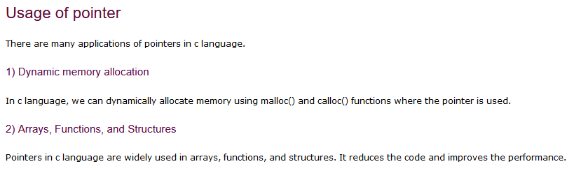

Slide 31
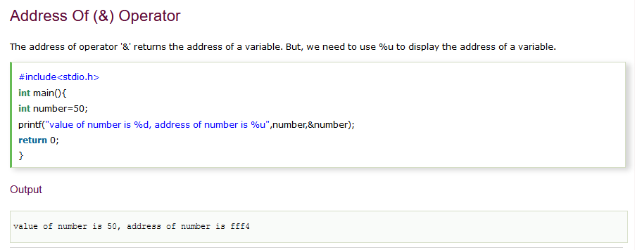

Slide 32
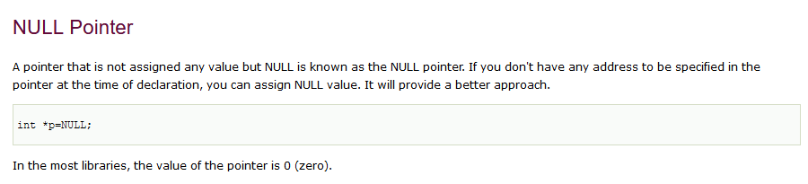

Slide 33

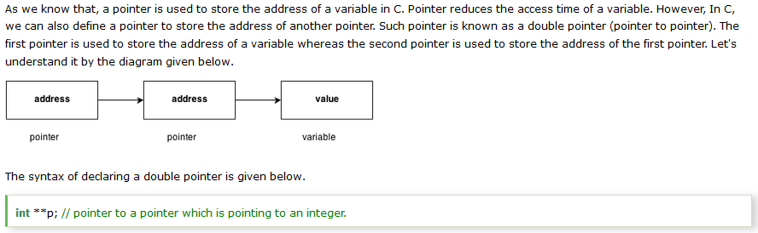

Slide 34
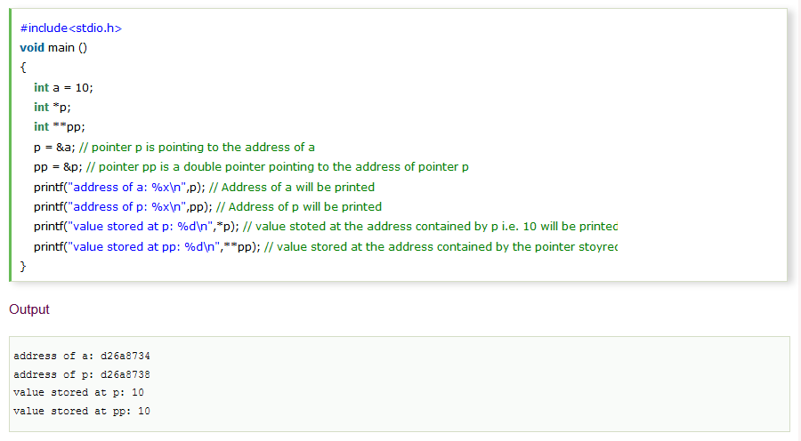

Slide 35
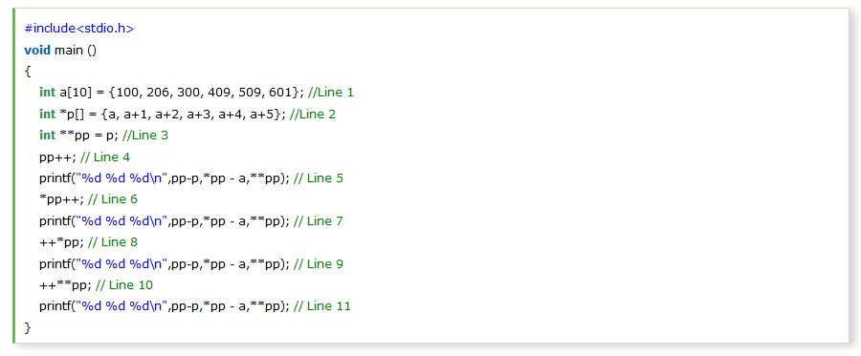
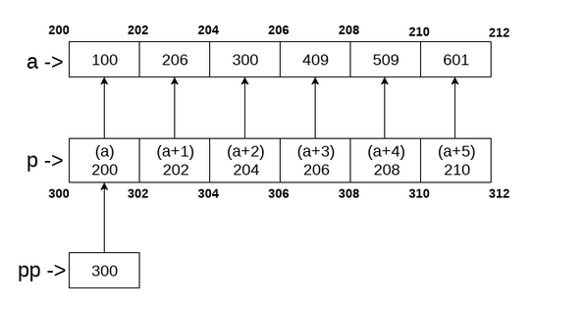
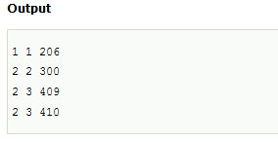

Slide 36

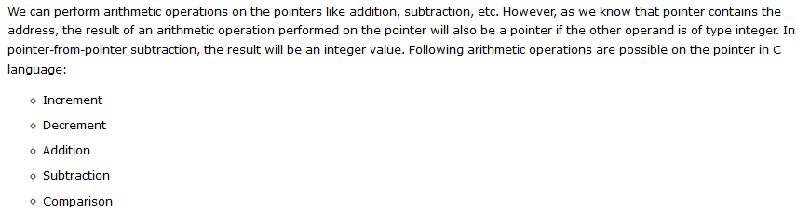

Slide 37
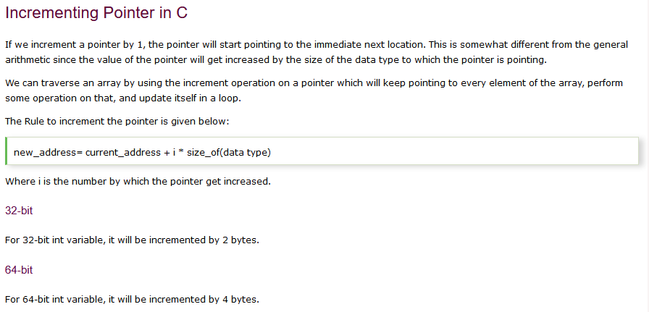

Slide 38
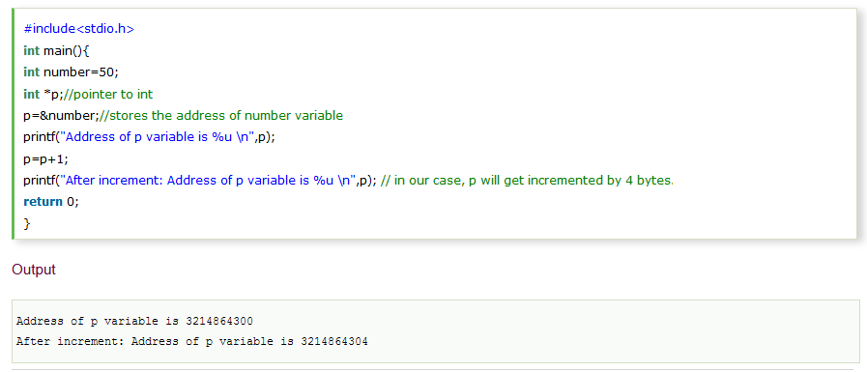

Slide 39
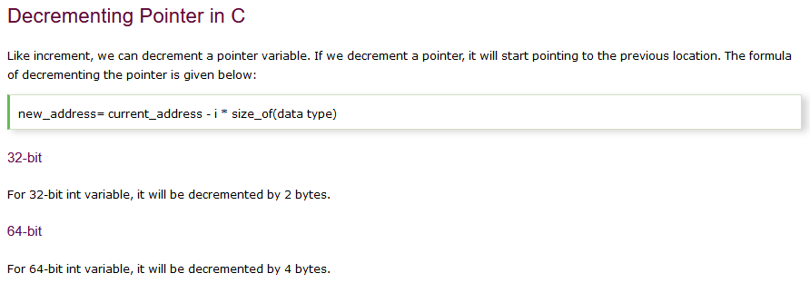

Slide 40
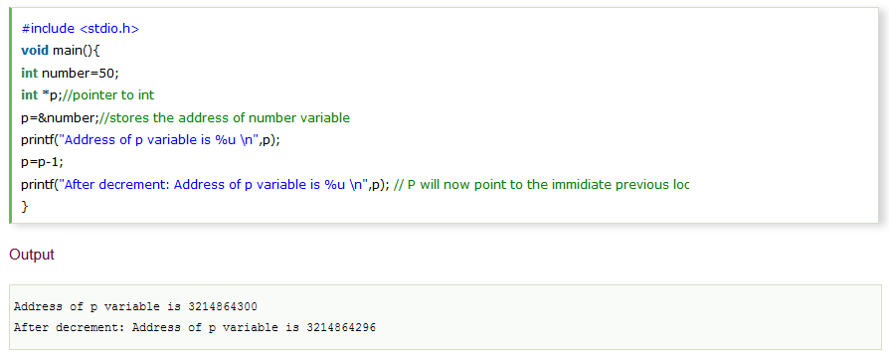

Slide 41
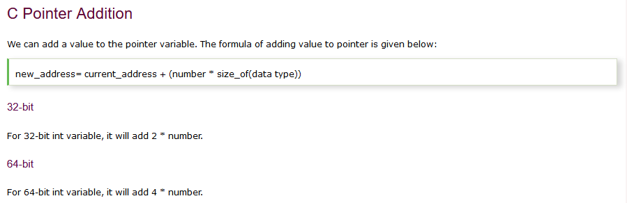

Slide 42
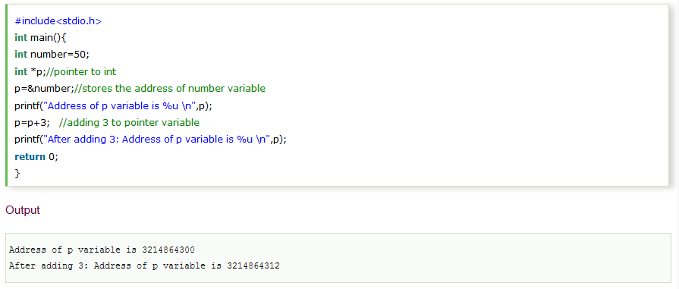

Slide 43
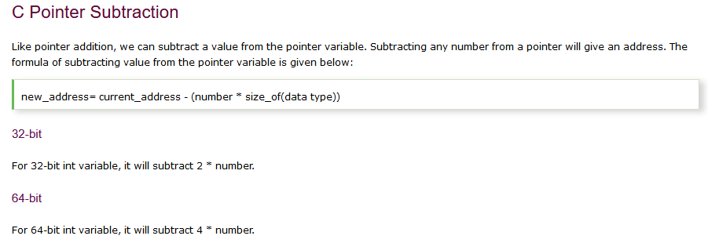

Slide 44
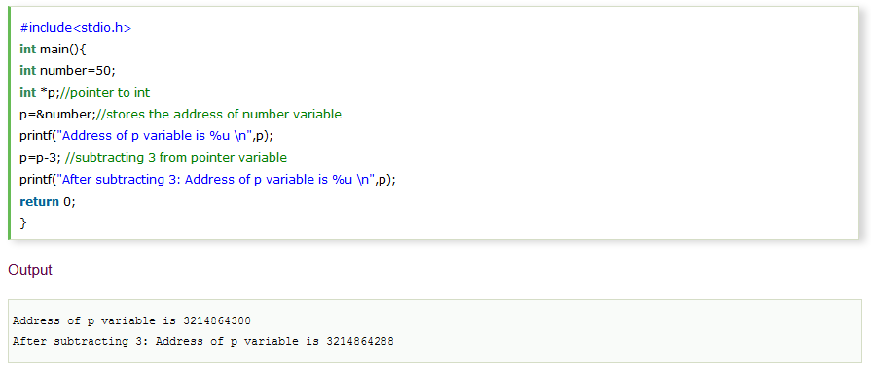

Slide 45
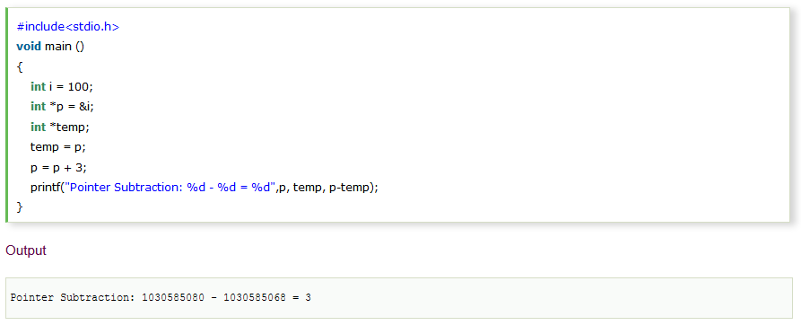

Slide 46
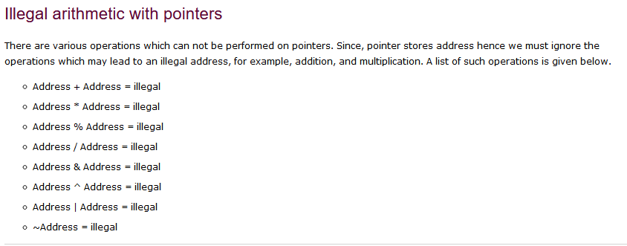

Slide 47
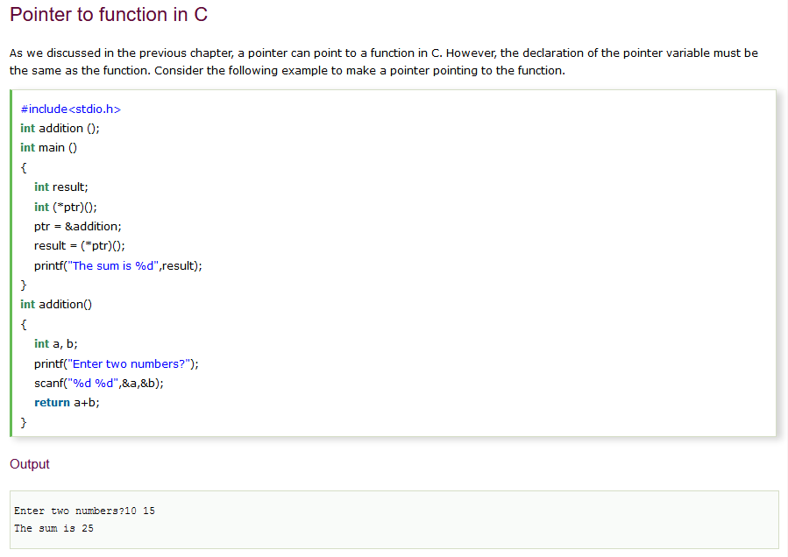

Slide 48

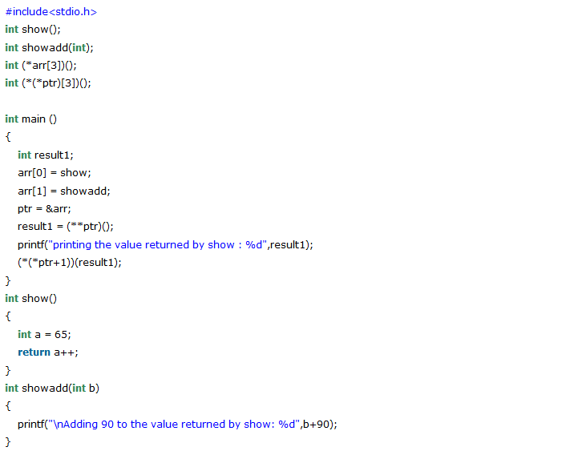


Slide 49

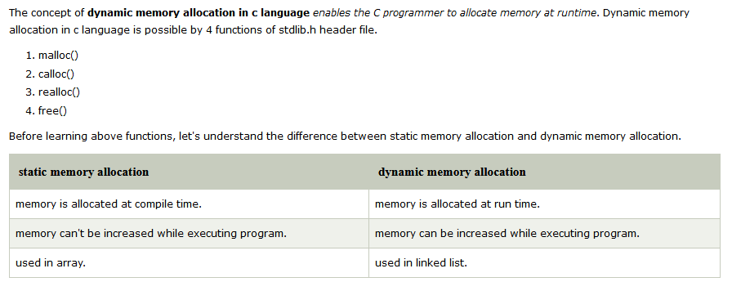

Slide 50
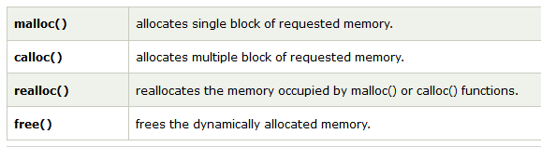

Slide 51


Slide 52



Slide 53


Slide 54



Slide 55


Slide 56


Slide 57


Slide 58


Slide 59


Slide 60


Slide 61


Slide 62


Slide 63


Slide 64



Slide 65



Slide 66



Slide 67



Slide 68



Slide 69



Slide 70


Array name gives the address of first element in array. So when we do '*ptr1 = arr;', ptr1 starts holding the address of element 10. 'arr + 5' gives the address of 6th element as arithmetic is done using pointers. So 'ptr2-ptr1' gives 5. When we do '(char *)ptr2', ptr2 is type-casted to char pointer and size of character is one byte, pointer arithmetic happens considering character pointers. So we get 5*sizeof(int)/sizeof(char) as a difference of two pointers.

Slide 71


Output is 513 in a little endian machine. To understand this output, let integers be stored using 16 bits. In a little endian machine, when we do x[0] = 1 and x[1] = 2, the number a is changed to 00000001 00000010 which is representation of 513 in a little endian machine.

Slide 72



Slide 73




Slide 74




